Slide 1
Microcontroller Based System Design
CSE 3215
Lecture 11

Slide 2
Inter Integrated Circuit Protocol (I2C)
It is a serial communication protocol allow to connect multiple slaves to a single master (like SPI) and multiple masters controlling single, or multiple slaves.
Only two wires are required for communication between up to almost 128 (112) devices when using 7 bits addressing and up to almost 1024 (1008) devices when using 10 bits addressing.
This is really useful when more than one microcontroller logging data to a single memory card or displaying text to a single LCD.

Slide 3
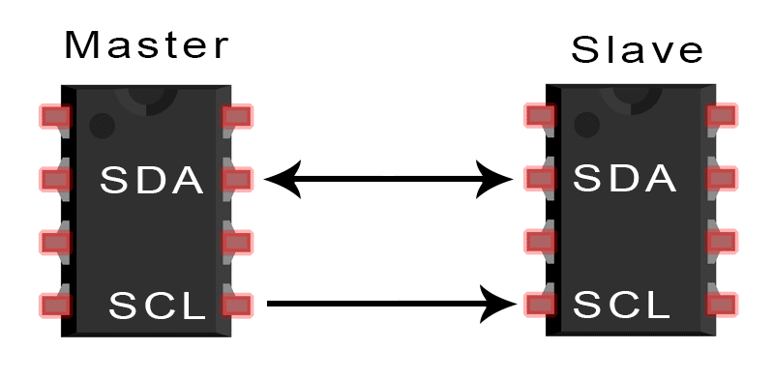
Inter Integrated Circuit Protocol (I2C)
SDA (Serial Data) – The line for the master and slave to send and receive data.
SCL (Serial Clock) – The line that carries the clock signal.

Slide 4
Inter Integrated Circuit Protocol (I2C)

Slide 5
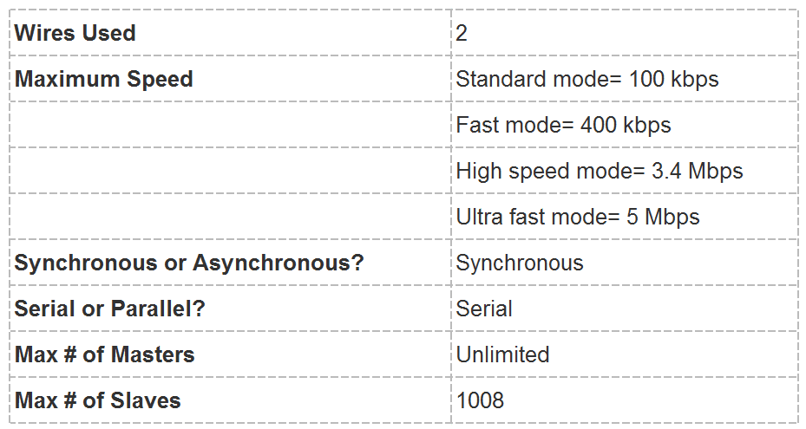
Inter Integrated Circuit Protocol (I2C)

Slide 6
Inter Integrated Circuit Protocol (I2C)
Signals of I2C
Each I2C bus consists of two signals: SCL and SDA.
SCL is the clock signal, and SDA is the data signal.
The clock signal is always generated by the current bus master.
Some slave devices may force the clock low at times to delay the master sending more data. This is called “clock stretching”.

Slide 7
HOW I2C WORKS
With I2C, data is transferred in messages.
Messages are broken up into frames of data.
Each message has an address frame that contains the binary address of the slave, and one or more data frames that contain the data being transmitted.
The message also includes start and stop conditions, read/write bits, and ACK/NACK bits between each data frame.

Slide 8
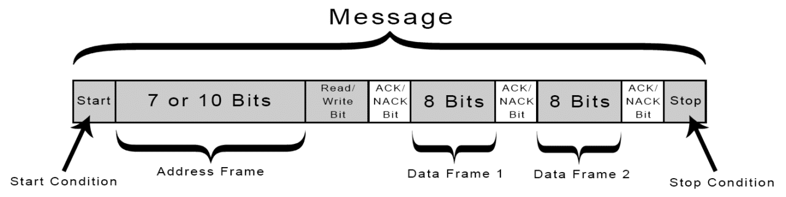
HOW I2C WORKS

Slide 9
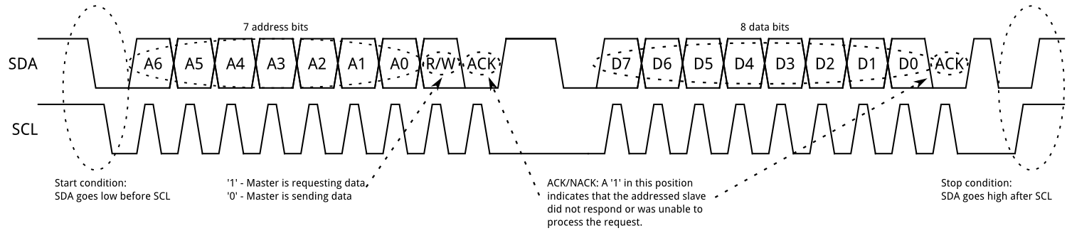
HOW I2C WORKS

Slide 10
HOW I2C WORKS
Start Condition:
To initiate the address frame, the master device leaves SCL high and pulls SDA low. This puts all slave devices on notice that a transmission is about to start. If two master devices wish to take ownership of the bus at one time, whichever device pulls SDA low first wins the race and gains control of the bus.

Slide 11
HOW I2C WORKS
Stop condition:
Once all the data frames have been sent, the master will generate a stop condition. Stop conditions are defined by a 0->1 (low to high) transition on SDA after a 0->1 transition on SCL, with SCL remaining high.
Address Frame:
A 7 or 10 bit sequence unique to each slave that identifies the slave when the master wants to talk to it.

Slide 12
HOW I2C WORKS
Data Frame:
After the master detects the ACK bit from the slave, the first data frame is ready to be sent.
The data frame is always 8 bits long, and sent with the most significant bit first. Each data frame is immediately followed by an ACK/NACK bit to verify that the frame has been received successfully. The ACK bit must be received by either the master or the slave (depending on who is sending the data) before the next data frame can be sent.

Slide 13
HOW I2C WORKS
Read/Write Bit:
The address frame includes a single bit at the end that informs the slave whether the master wants to write data to it or receive data from it. If the master wants to send data to the slave, the read/write bit is a low voltage level. If the master is requesting data from the slave, the bit is a high voltage level.
ACK/NACK Bit:
Each frame in a message is followed by an acknowledge/no-acknowledge bit. If an address frame or data frame was successfully received, an ACK bit is returned to the sender from the receiving device.

Slide 14
ADDRESSING
I2C doesn’t have slave select lines like SPI, so it needs another way to let the slave know that data is being sent to it, and not another slave. It does this by addressing. The address frame is always the first frame after the start bit in a new message.
The master sends the address of the slave it wants to communicate with to every slave connected to it. Each slave then compares the address sent from the master to its own address. If the address matches, it sends a low voltage ACK bit back to the master. If the address doesn’t match, the slave does nothing and the SDA line remains high.

Slide 15
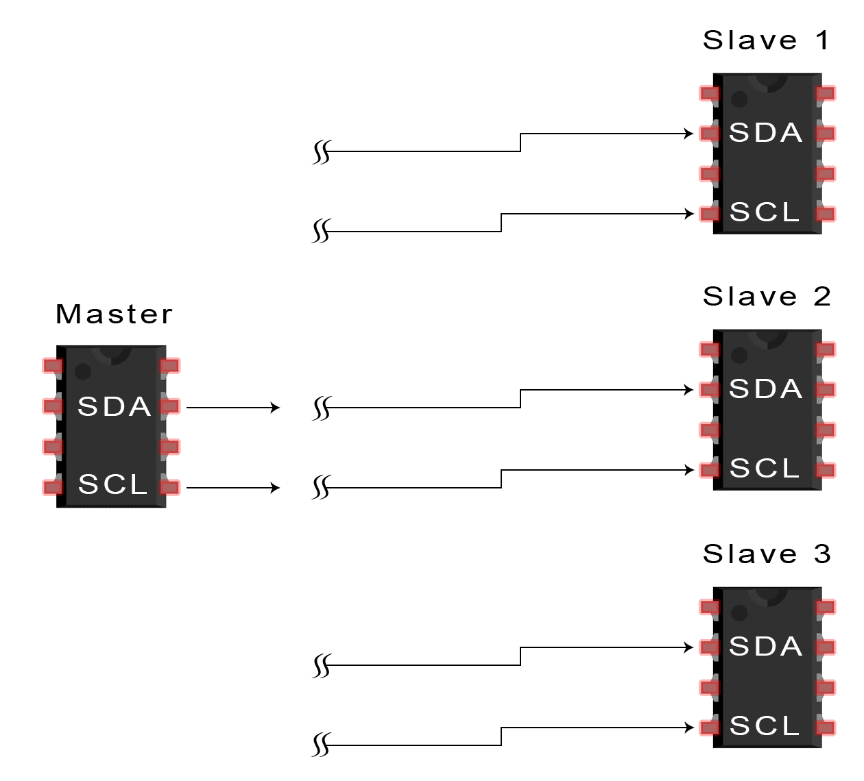
STEPS OF I2C DATA TRANSMISSION
1. The master sends the start condition to every connected slave by switching the SDA line from a high voltage level to a low voltage level before switching the SCL line from high to low.

Slide 16
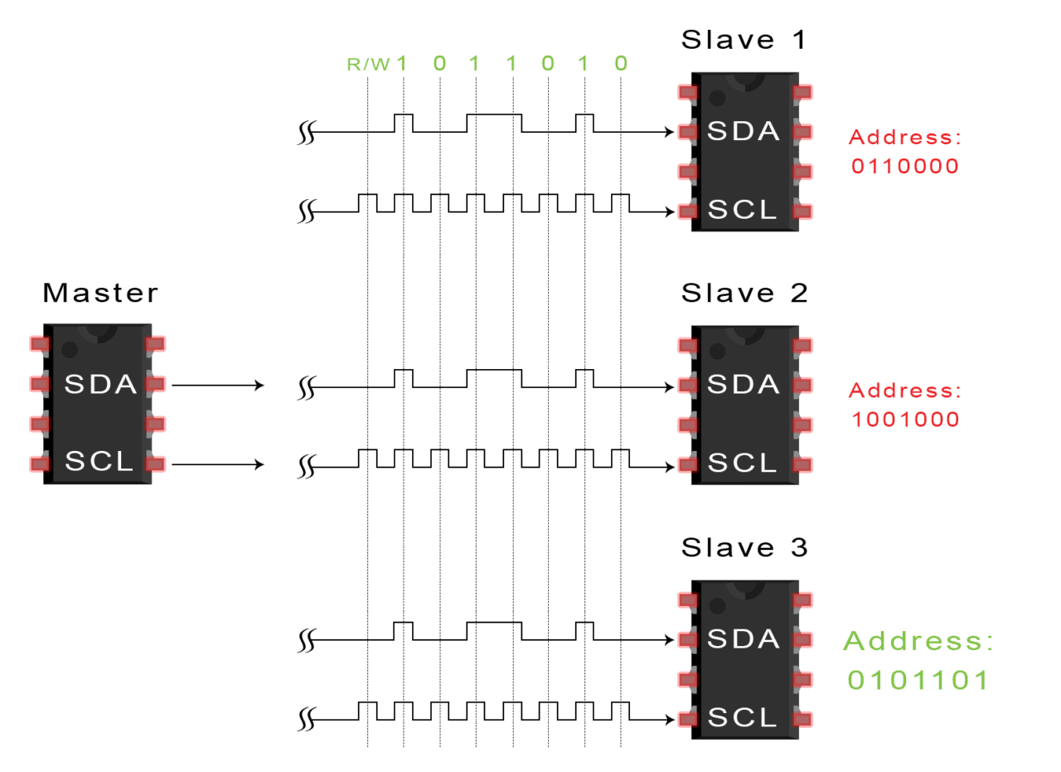
STEPS OF I2C DATA TRANSMISSION
2. The master sends each slave the 7 or 10 bit address of the slave it wants to communicate with, along with the read/write bit.

Slide 17
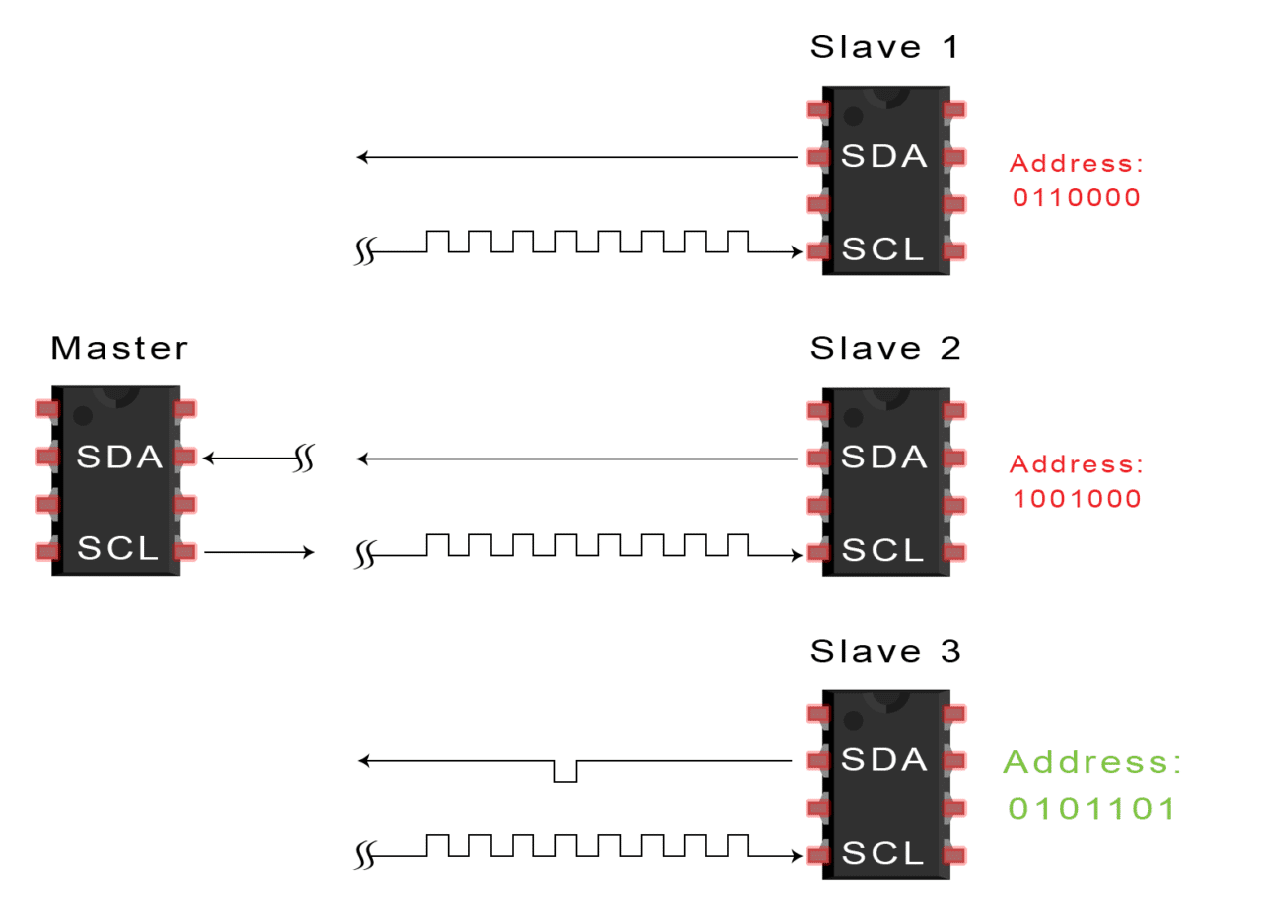
STEPS OF I2C DATA TRANSMISSION
3. Each slave compares the address sent from the master to its own address. If the address matches, the slave returns an ACK bit by pulling the SDA line low for one bit. If the address from the master does not match the slave’s own address, the slave leaves the SDA line high.

Slide 18
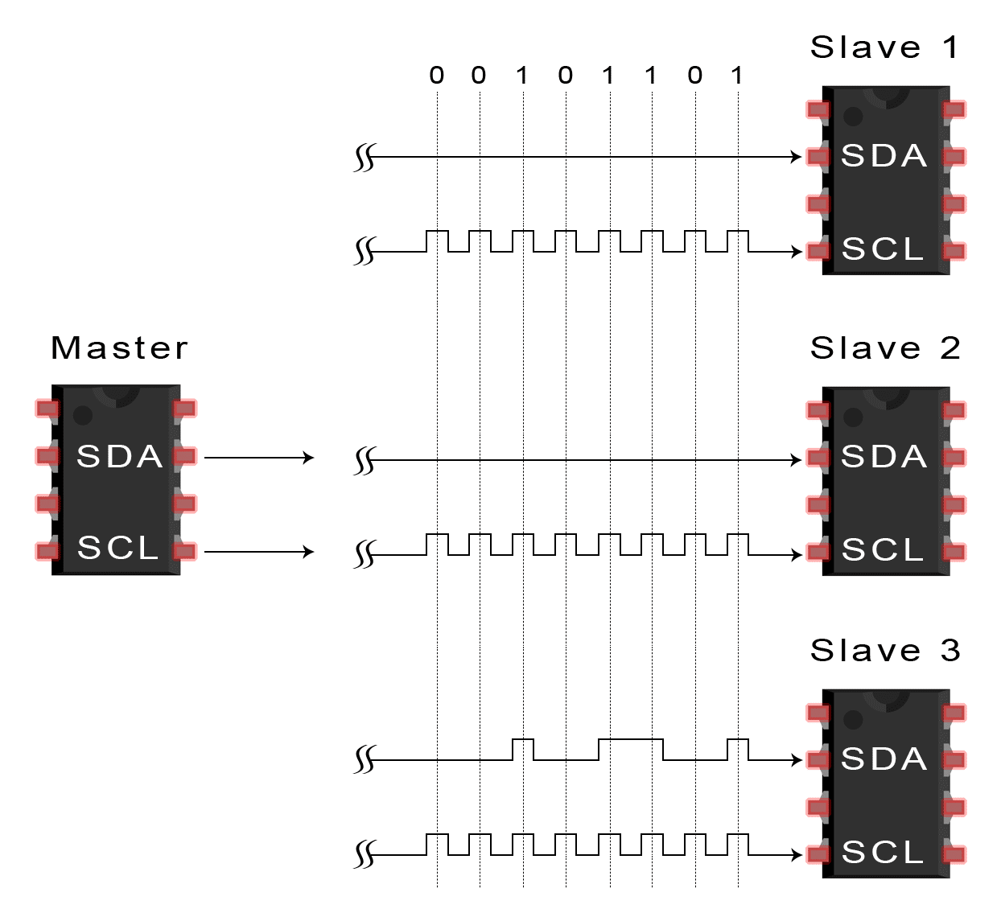
STEPS OF I2C DATA TRANSMISSION
4. The master sends or receives the data frame.

Slide 19
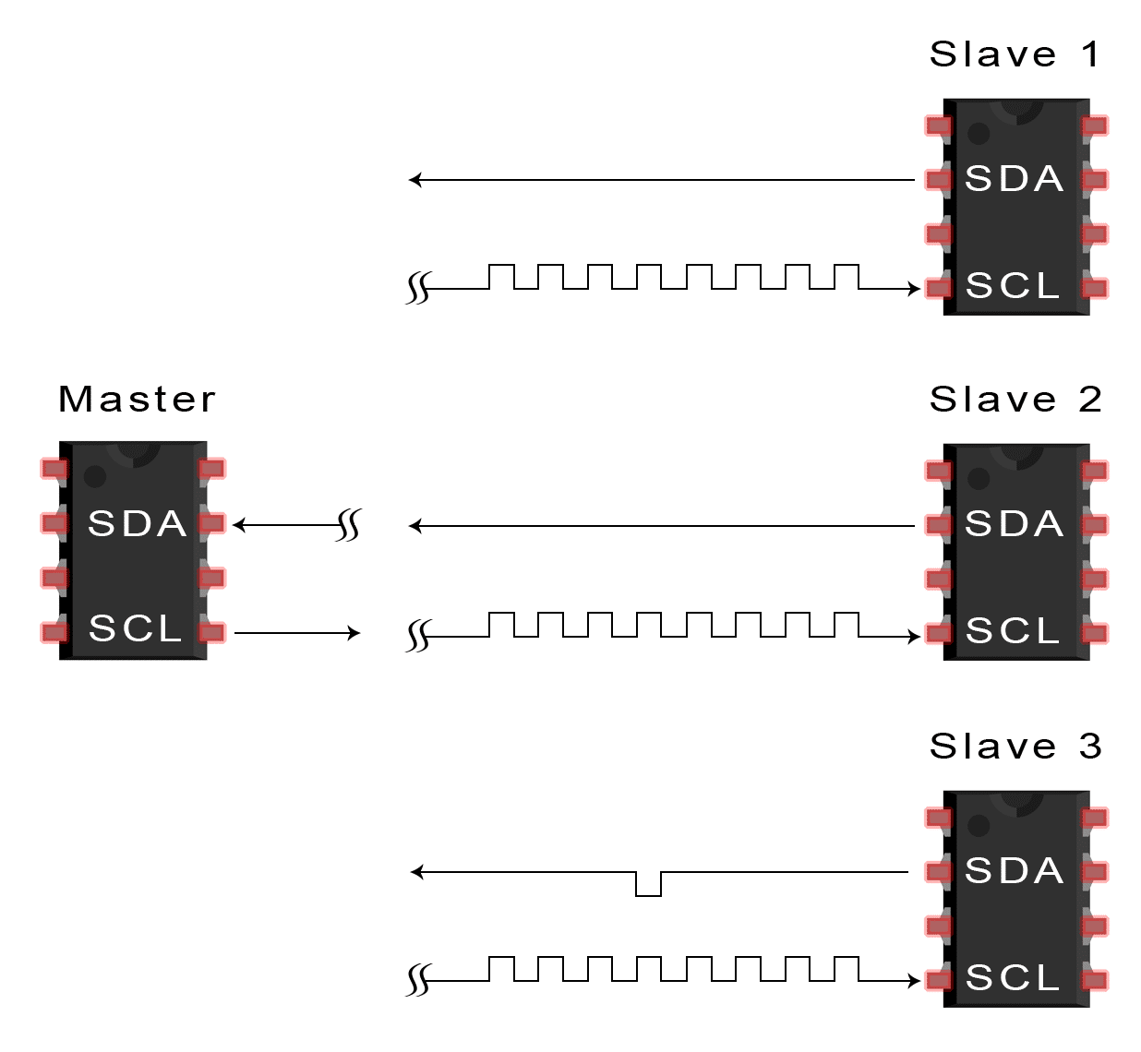
STEPS OF I2C DATA TRANSMISSION
5. After each data frame has been transferred, the receiving device returns another ACK bit to the sender to acknowledge successful receipt of the frame.

Slide 20
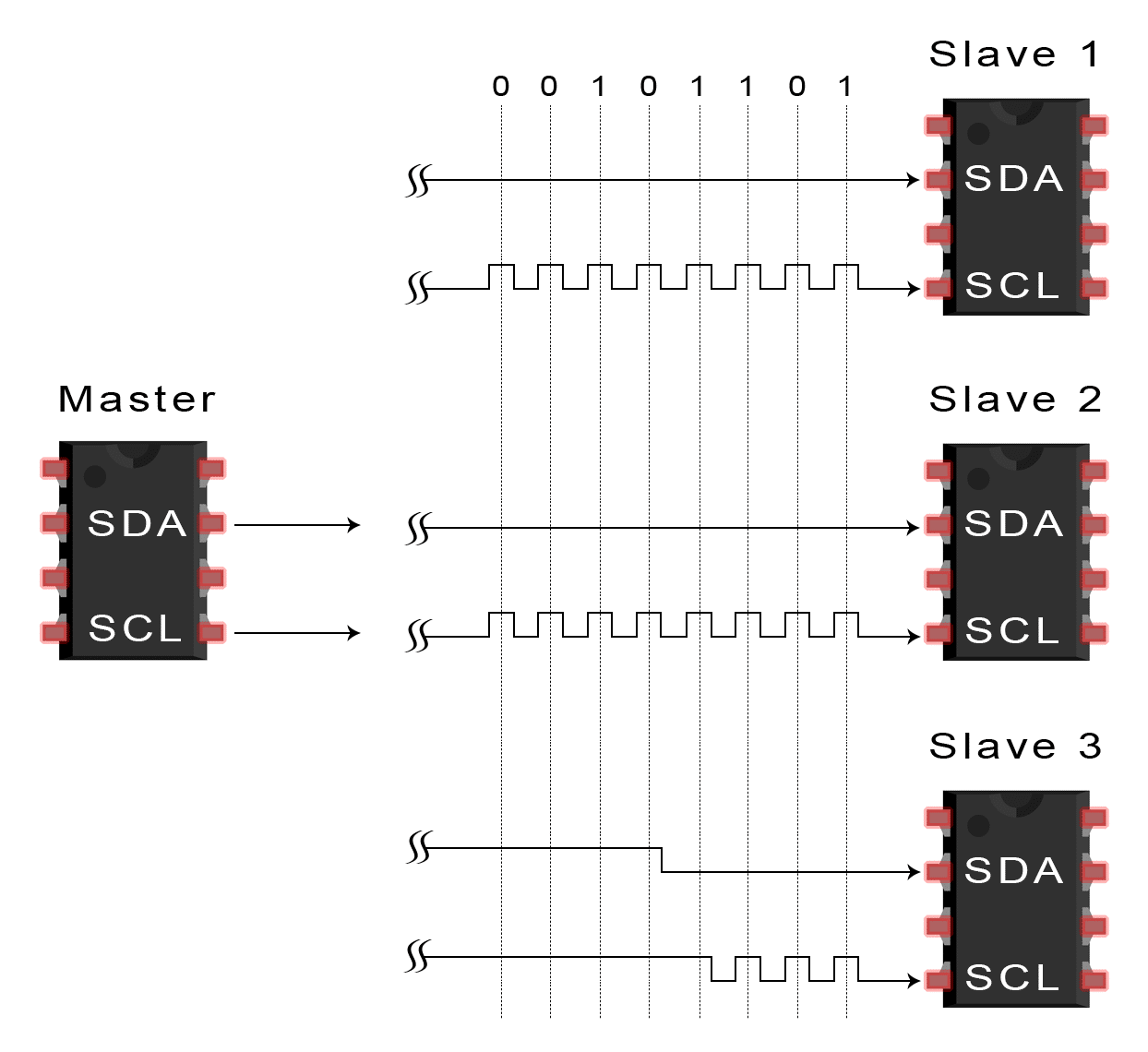
STEPS OF I2C DATA TRANSMISSION
6. To stop the data transmission, the master sends a stop condition to the slave by switching SCL high before switching SDA high.

Slide 21
Advantages of I2C
Only uses two wires
Supports multiple masters and multiple slaves
ACK/NACK bit gives confirmation that each frame is transferred successfully
Hardware is less complicated than with UARTs
Well known and widely used protocol

Slide 22
Disadvantages of I2C
Slower data transfer rate than SPI
The size of the data frame is limited to 8 bits

Slide 23
ARDUINO Wire Library
This library allows to communicate with I2C / TWI devices.
Board | I2C / TWI pins
Uno | A4 (SDA), A5 (SCL)
Mega2560 | 20 (SDA), 21 (SCL)
Leonardo | 2 (SDA), 3 (SCL)
Due | 20 (SDA), 21 (SCL), SDA1, SCL1

Slide 24
ARDUINO Wire Library Functions
begin()
requestFrom()
beginTransmission()
endTransmission()
write()
available()
read()
SetClock()
onReceive()
onRequest()

Slide 25
Master Reader/Slave Sender
Circuit
Connect pin 4 (the data, or SDA, pin) and pin 5 (the clock, or SCL, pin) on the master board to their counterparts on the slave board. Make sure that both boards share a common ground. In order to enable serial communication, the master board must be connected to your computer via USB.
If powering the boards independently is an issue, connect the 5V output of the Master to the VIN pin on the slave.

Slide 26
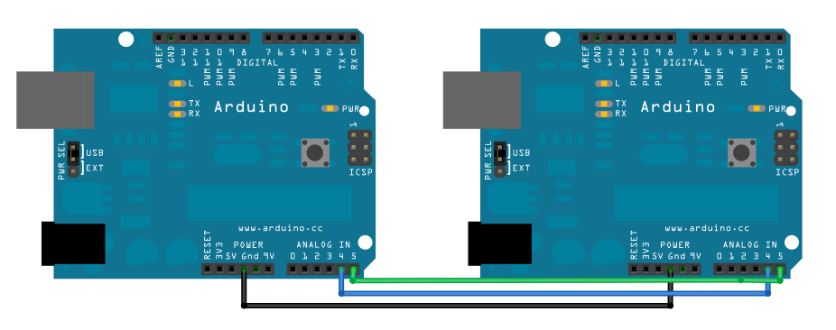
Master Reader/Slave Sender

Slide 27
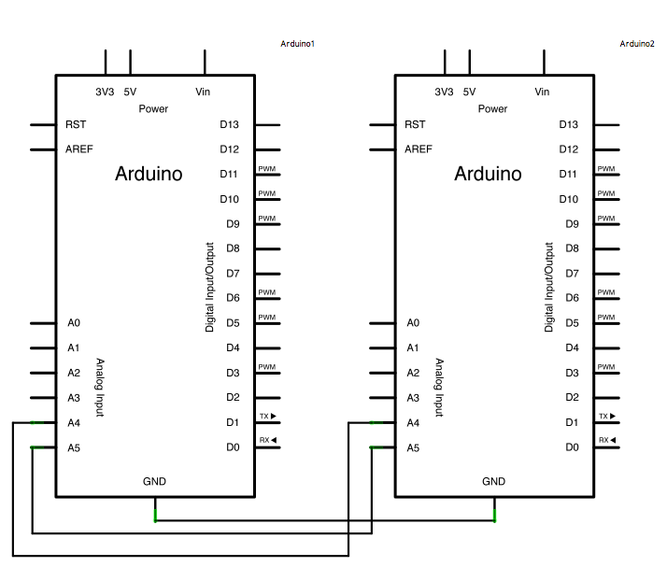
Master Reader/Slave Sender
Schematic

Slide 28
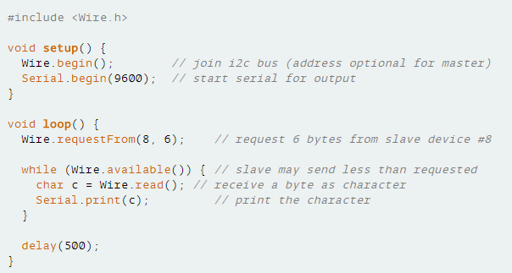
Code for Master Reader - Program for Arduino 1

Slide 29
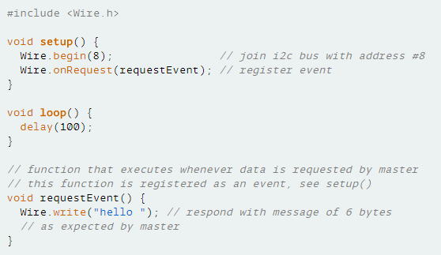
Code for Slave Sender - Program for Arduino 2

Slide 30
Master Writer/Slave Receiver
Circuit
Connect pin 5 (the clock, or SCL, pin) and pin 4 (the data, or SDA, pin) on the master Arduino to their counterparts on the slave board. Make sure that both boards share a common ground. In order to enable serial communication, the slave Arduino must be connected to your computer via USB.
If powering the boards independently is an issue, connect the 5V output of the Master to the VIN pin on the slave.

Slide 31
Master Writer/Slave Receiver

Slide 32
Master Writer/Slave Receiver
Schematic

Slide 33
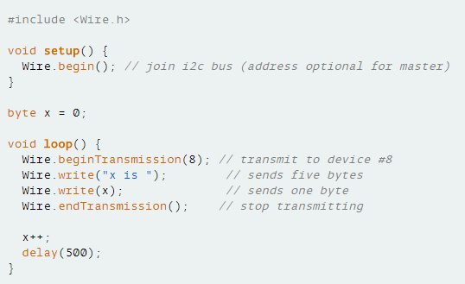
Master Writer Code - Program for Arduino 1

Slide 34
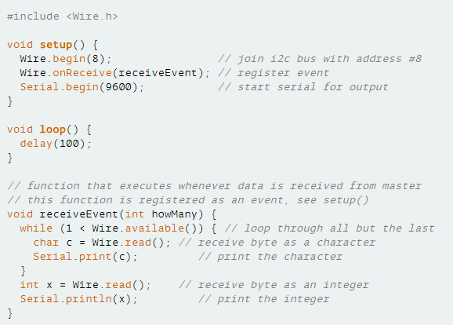
Slave Receiver Code - Program for Arduino 2

Slide 35
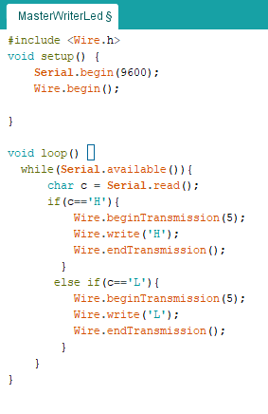
Master Writer Code – LED Blink

Slide 36
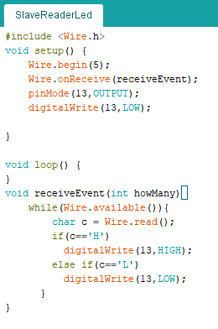
Slave Receiver Code – LED Blink

Slide 37
Functions
Wire.begin()
Wire.begin(address)
Description
Initiate the Wire library and join the I2C bus as a master or slave. This should normally be called only once.
Parameters
address: the 7-bit slave address (optional); if not specified, join the bus as a master.
Returns
None

Slide 38
Functions
Wire.requestFrom()
Description
Used by the master to request bytes from a slave device. The bytes may then be retrieved with the available() and read()functions.
If true, requestFrom() sends a stop message after the request, releasing the I2C bus.
If false, requestFrom() sends a restart message after the request. The bus will not be released, which prevents another master device from requesting between messages. This allows one master device to send multiple requests while in control.
The default value is true.

Slide 39
Functions
Wire.requestFrom()
Syntax
Wire.requestFrom(address, quantity) Wire.requestFrom(address, quantity, stop)
Parameters
address: the 7-bit address of the device to request bytes from
quantity: the number of bytes to request
stop : boolean. true will send a stop message after the request, releasing the bus. false will continually send a restart after the request, keeping the connection active.
Returns
byte : the number of bytes returned from the slave device

Slide 40
Functions
Wire.available()
Description
Returns the number of bytes available for retrieval with read(). This should be called on a master device after a call to requestFrom() or on a slave inside the onReceive() handler
Parameters
None
Returns
The number of bytes available for reading.

Slide 41
Functions
read()
Description
Reads a byte that was transmitted from a slave device to a master after a call to requestFrom() or was transmitted from a master to a slave.
Syntax
Wire.read()
Parameters
none
Returns
The next byte received

Slide 42
Functions
Wire.onRequest(handler)
Description
Register a function to be called when a master requests data from this slave device.
Parameters
handler: the function to be called, takes no parameters and returns nothing, e.g.: void myHandler()
Returns
None

Slide 43
Functions
Wire.onReceive(handler)
Description
Registers a function to be called when a slave device receives a transmission from a master.
Parameters
handler: the function to be called when the slave receives data; this should take a single int parameter (the number of bytes read from the master) and return nothing, e.g.: void myHandler(int numBytes)
Returns
None

Slide 44
Functions
write()
Description
Writes data from a slave device in response to a request from a master, or queues bytes for transmission from a master to slave device (in-between calls to beginTransmission() and endTransmission()).
Syntax
Wire.write(value) Wire.write(string) Wire.write(data, length)

Slide 45
Functions
Parameters
value: a value to send as a single byte
string: a string to send as a series of bytes
data: an array of data to send as bytes
length: the number of bytes to transmit
Returns
byte: write() will return the number of bytes written, though reading that number is optional

Slide 46
Functions
Wire.beginTransmission(address)
Description
Begin a transmission to the I2C slave device with the given address. Subsequently, queue bytes for transmission with the write() function and transmit them by calling endTransmission().
Parameters
address: the 7-bit address of the device to transmit to
Returns
None

Slide 47
Functions
Wire.endTransmission()
Description
Ends a transmission to a slave device that was begun by beginTransmission() and transmits the bytes that were queued by write().
If true, endTransmission() sends a stop message after transmission, releasing the I2C bus.
If false, endTransmission() sends a restart message after transmission. The bus will not be released, which prevents another master device from transmitting between messages. This allows one master device to send multiple transmissions while in control.
The default value is true.

Slide 48
Functions
Wire.endTransmission()
Syntax
Wire.endTransmission() Wire.endTransmission(stop)
Parameters
stop : boolean. true will send a stop message, releasing the bus after transmission. false will send a restart, keeping the connection active.

Slide 49
Functions
Wire.endTransmission()
Returns
byte, which indicates the status of the transmission:
0:success
1:data too long to fit in transmit buffer
2:received NACK on transmit of address
3:received NACK on transmit of data
4:other error

Slide 50
Thank You

